Slide 1
"Unlocking AI-Powered Job Market Insights: Data-Driven Workforce Trends in Power BI"

Slide 2


This captures the use of AI for insights and the data visualization aspect with Power BI.

Slide 3
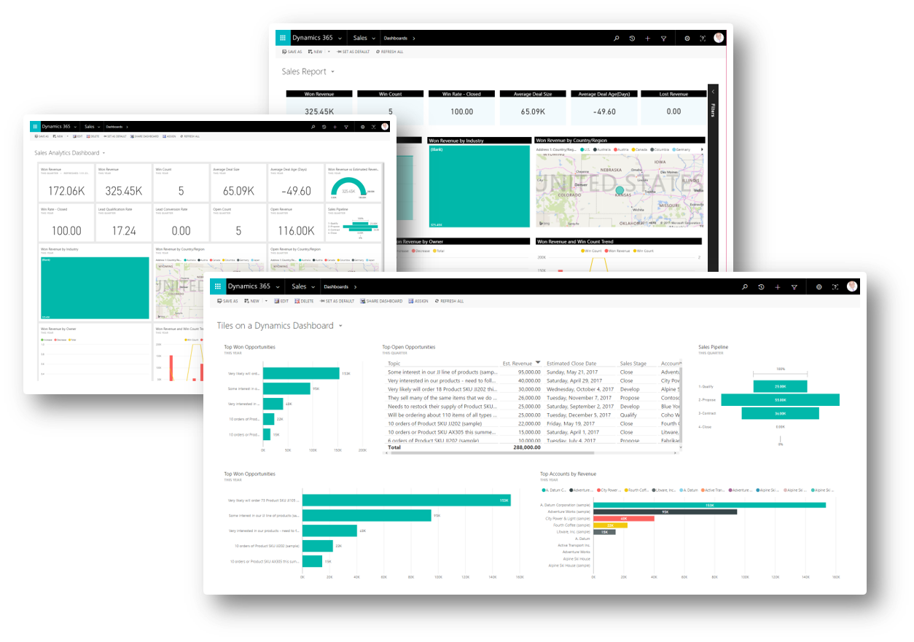
WHAT is Power Bi ?
Data visualization tool by Microsoft
Connects to various data sources
Real-time data monitoring and analysis
User-friendly report building
Supports collaboration and sharing
AI-powered analytics and insights
Customizable dashboards and visuals

Slide 4
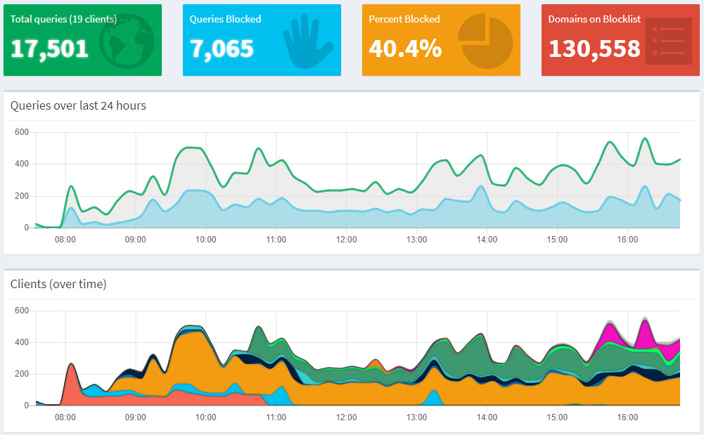

Dashboard
01

Slide 5
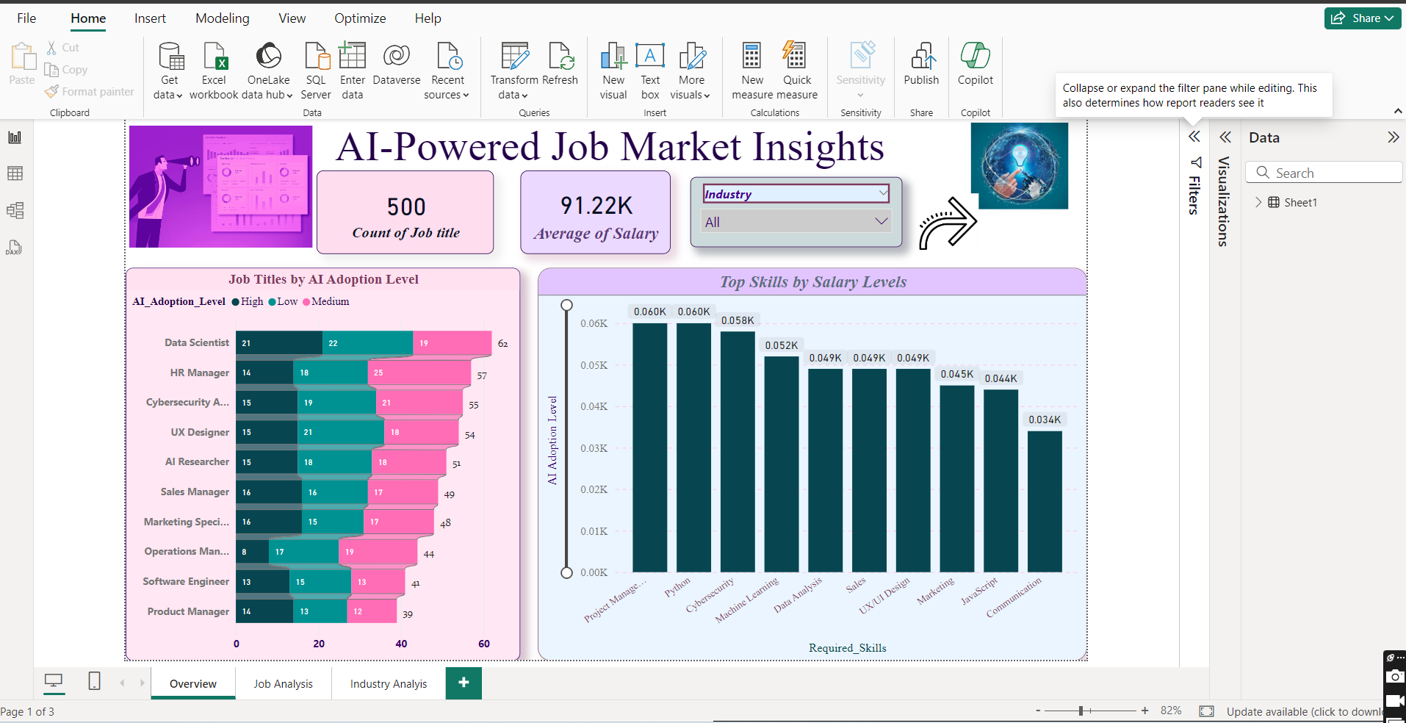
AI-Powered Job Market Insights

Slide 6
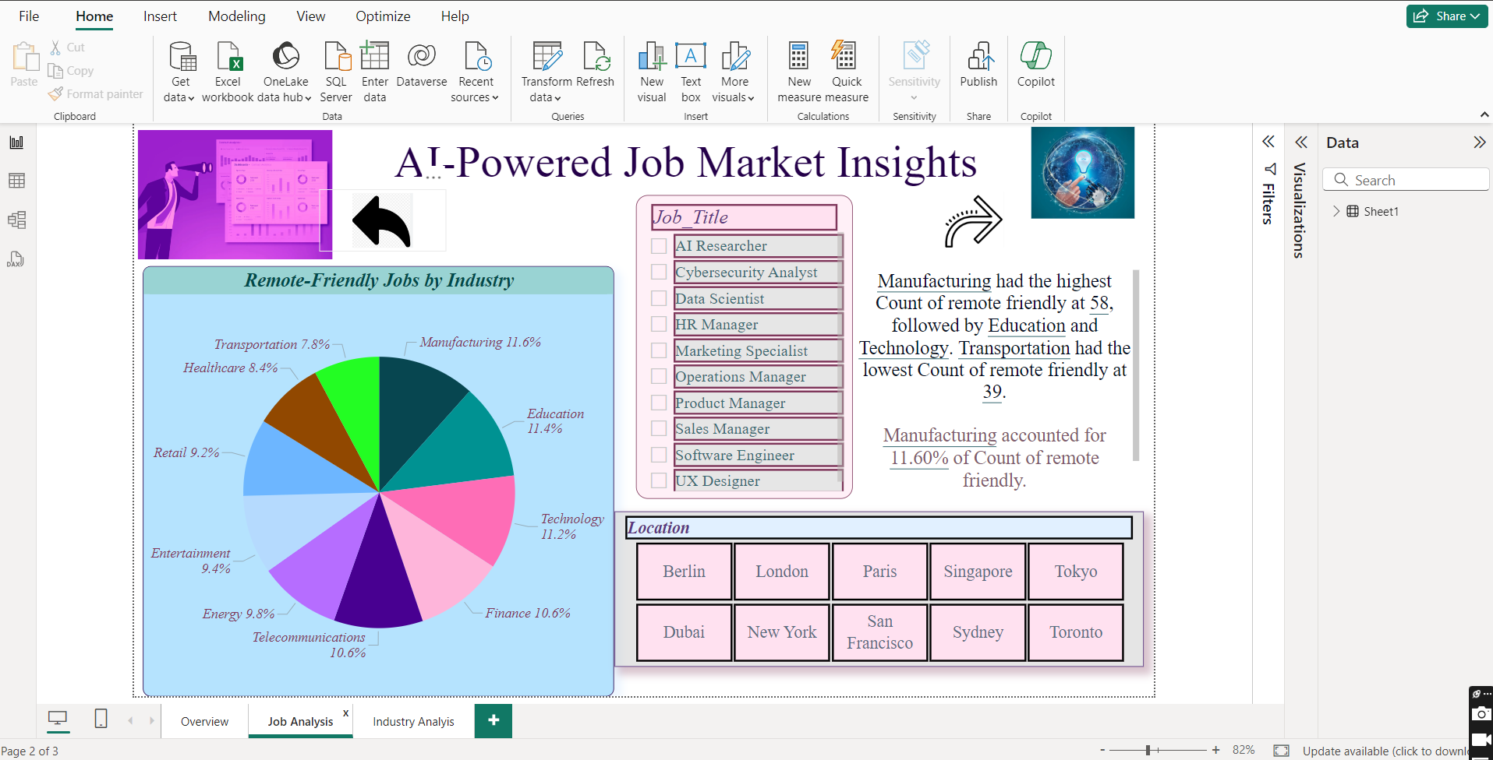
AI-Powered Job Market Insights

Slide 7
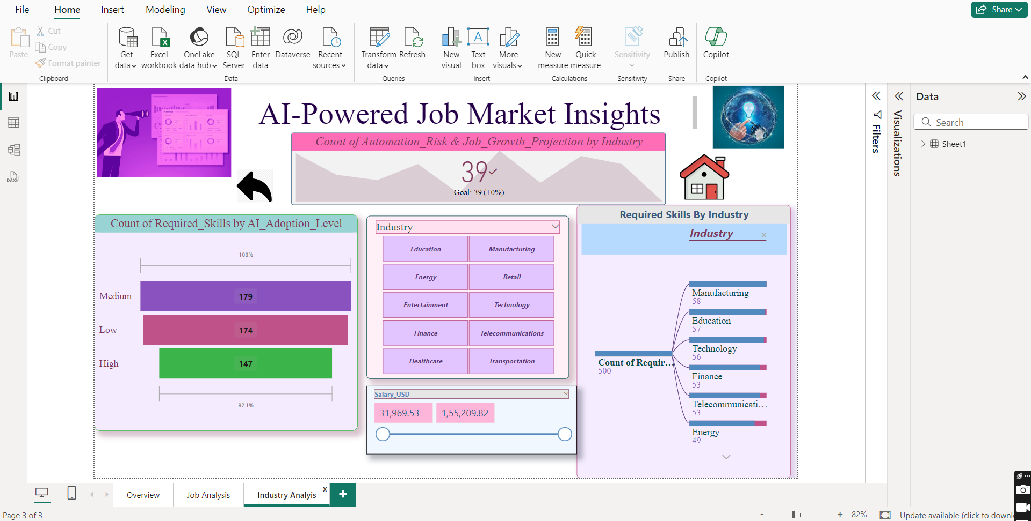
AI-Powered Job Market Insights

Slide 8
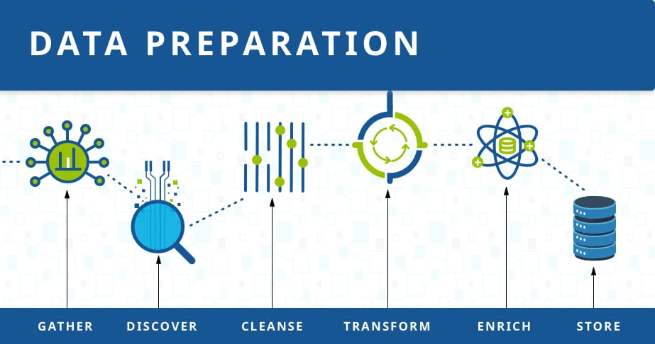
STEP 01
Preparing Data
Load Data: Open Power BI and load your dataset (either from
Excel, CSV, database, etc.). Go to the Home tab, select Get
Data, and then select the appropriate file format to import.
Data Cleaning (Optional):
Use Power Query to clean and transform the data if
Review the data for any missing values or inconsistencies.
needed (for instance, categorizing AI adoption levels,
standardizing locations, etc.).

Slide 9
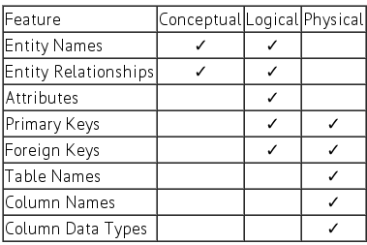
STEP 02
Data Model Setup
1.Check Data Types: Ensure that the fields have the
appropriate data types:
Job Title, Industry, Company, Location, Required_Skills, and
Remote_Friendly: Text/Categorical
AI_Adoption_Level: Text/Categorical (e.g., Low, Medium, High)
Automation_Risk: Percentage/Decimal
Salary_USD: Currency
Job_Growth_Projection: Percentage/Decimal
2.Create Relationships (if needed): If your data is spread
across multiple tables, create relationships between tables
based on common fields (e.g., job ID, company, etc.).

Slide 10

02
Designing Visualizations

Slide 11
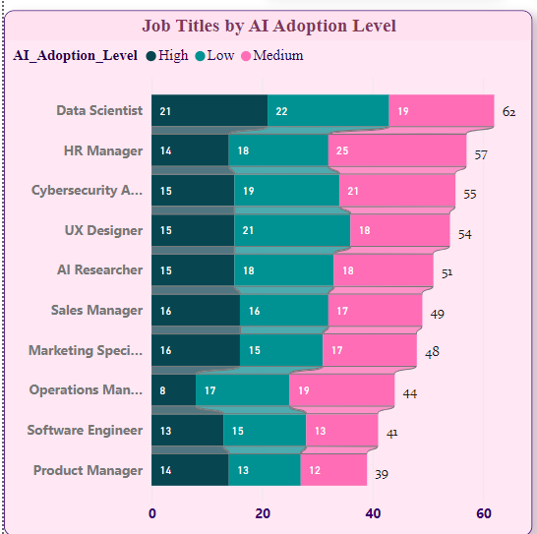

Bar Chart (Job Titles by AI Adoption Level):
We created a Bar Chart to visualize Job Titles by AI Adoption Level. We categorized job titles based on their level of AI integration (e.g., Low, Medium, High) and displayed the distribution of job roles across these categories. This helped identify which job titles are leading or lagging in AI adoption, providing a clear comparison through the bar lengths for each category.
This Photo by Unknown Author is licensed under CC BY

Slide 12
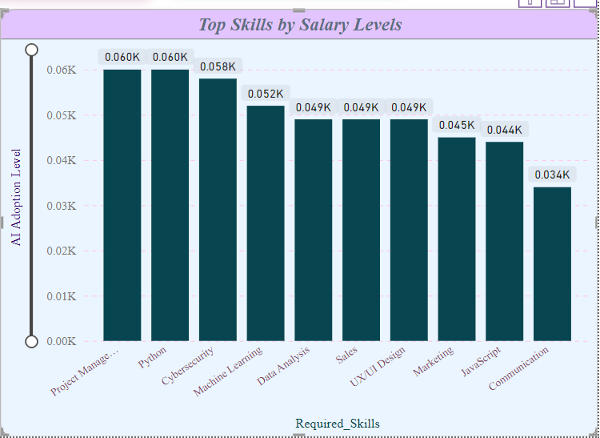
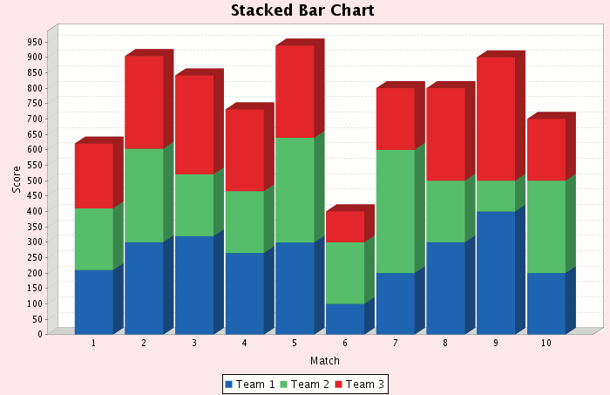
Clustered Column Chart (Top Skills by Salary Levels):
We developed a Clustered Column Chart to display the Top Skills by Salary Levels. This chart shows the relationship between key skills and their corresponding salary brackets, allowing us to compare how different skills impact salary levels. Each column represents a skill, with different salary levels clustered within the columns, providing insights into which skills are most valuable in the job market.

Slide 13
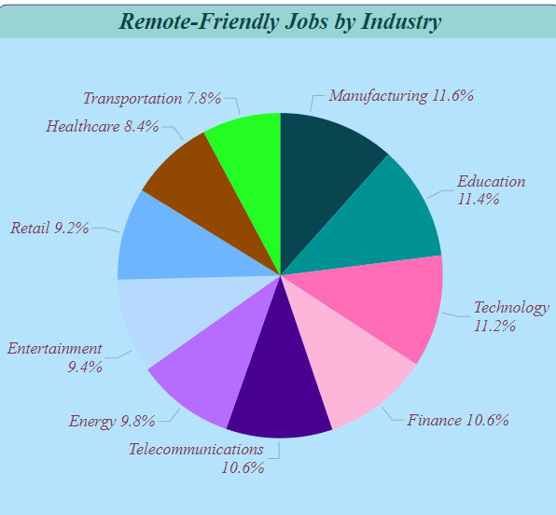

Pie Chart (Remote-Friendly Jobs by Industry):
We created a Pie Chart to showcase the distribution of Remote-Friendly Jobs by Industry. Each sector is represented as a slice of the pie, showing the proportion of remote-friendly roles in various industries. This visual helps identify which industries offer more remote work opportunities, with larger slices indicating higher prevalence of remote roles.

Slide 14
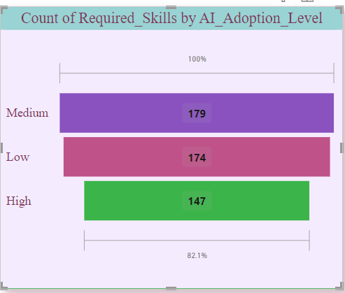
Funnel chart (count of required skills by adoption level) :
We built a Funnel Chart to represent the Count of Required Skills by AI Adoption Level. The chart visually displays the number of skills needed at each level of AI adoption (e.g., Low, Medium, High), with the widest section representing the highest count and narrowing down for fewer skills. This helps highlight how skill requirements change as AI adoption increases.

Slide 15
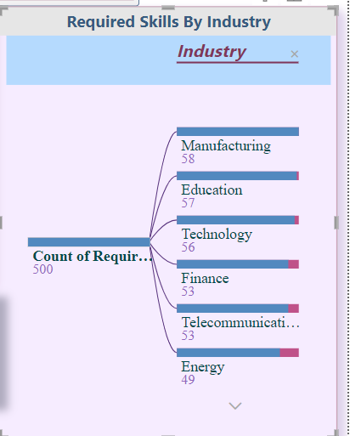
Decomposition Tree (Required skills by Industry):
We used a Decomposition Tree to analyze Required Skills by Industry. This visual breaks down the required skills across different industries, allowing us to drill into specific sectors and identify which skills are most in demand. The tree structure helps explore relationships between industries and skill sets, providing detailed insights into industry-specific skill requirements.

Slide 16

KPI Cards:
We created two key metrics:
Total Jobs: This KPI card displays the count of unique job titles, providing a clear overview of job market diversity.
Average Salary: This KPI card shows the average salary in USD, offering insights into overall compensation trends across job titles.
Together, these metrics provide a quick snapshot of the job landscape and salary expectations.

Slide 17
Adding Filters/Slicers
03

Slide 18
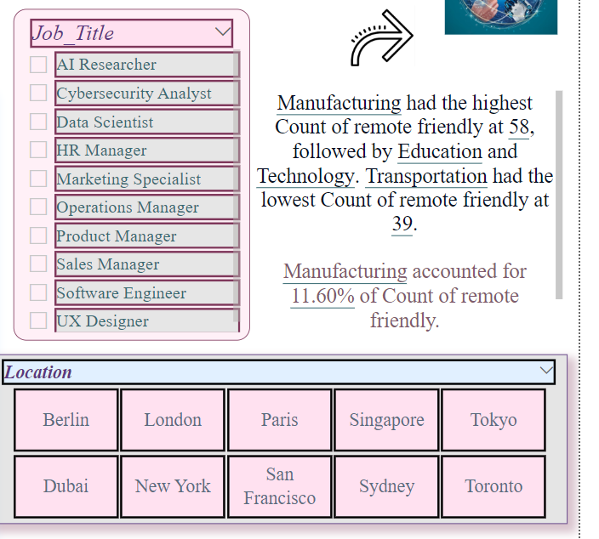
STEP 04
Adding Filters/Slicers
Filters:
Definition: Filters are criteria that limit the data shown in visualizations based on specific conditions.
Slicers:
Definition: Slicers are a type of visual filter
that provides a user-friendly way to filter
data interactively.

Slide 19
KPI Cards:
Slicers in Power BI allow users to dynamically filter the data:
Job Title Slicer: Allows the user to filter the visualizations based on the selected job title.
Location Slicer: Add a slicer for Location to filter by cities, regions, or countries.
Industry Slicer: Drag the Industry field into the slicer to allow filtering by the industry.
AI Adoption Level Slicer: Create a slicer for AI_Adoption_Level (Low, Medium, High).
Salary Range Slicer: Use a numeric range slicer for Salary_USD to filter based on salary ranges.
Remote-Friendly Slicer: Add a slicer for Remote_Friendly (Yes/No) to filter jobs that allow remote work.

Slide 20

Thank You !

